Slide 1
IOT Project - Air Quality Monitoring System
By Aishwarya(CB.EN.U4CSE16203)
Srijha (CB.EN.U4CSE16251)
Pawan(CB.EN.U4CSE16229)

Slide 2

Problem Statement
To design an IOT based Air Pollution Monitoring System which used to monitor and analyse air quality real-time and log data to the cloud,keeping the data updated over the internet. Air quality measurements are taken based on the Parts per million metrics.

Slide 3
Background
In the present day, critical global issue is an air pollution which impacts negatively on the ecosystem, economy, and human health. The proposed system consists of sensors to sense harzardous gases,temperature and humidity persistently and send out results to embedded controller. A simple alert and LED is used to indicate exceed in hazardous gases.

Slide 4


Features | Previous Related Works | Proposed Model
Checking environmental parameters to be measured Study the characteristic features on the sensor device Decision making on sensing, measuring and fixing the threshold value for the parameters Storing the data in cloud Calculating the Air quality index Predicting the AQI using Machine learning algorithms based on the person’s location Alert provided using buzzers depending on AQI level GPS for locating areas with pollution. Providing information via SMS
Paper 1 | Paper 2 | Paper 3

Slide 5
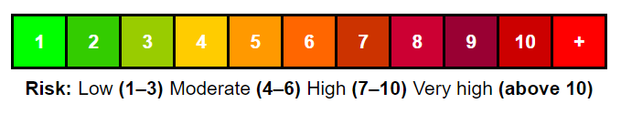

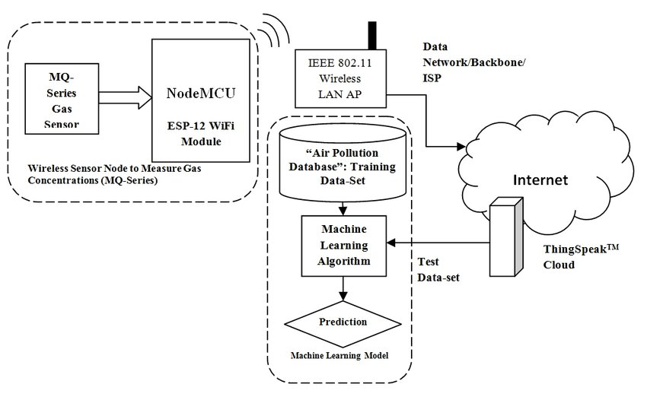
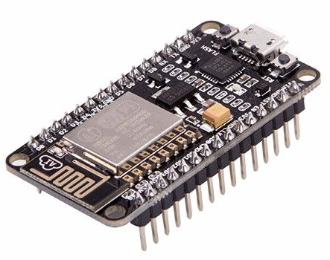




Architecture
Temperature sensor
Humidity sensor
Air Quality Gas Sensor
GPS
AQI calculation and Decision Making

Slide 6
Components Required
Sensors:
MQ135 Gas sensor,
MQ-6 sensor (LPG sensor)
Temperature sensor LM35 12)
Humidity sensor SY-H5220
GPS
Node MCU
Arduino
Wi-Fi module ESP8266
Buzzer
LED

Slide 7
THANKS

